Slide 2
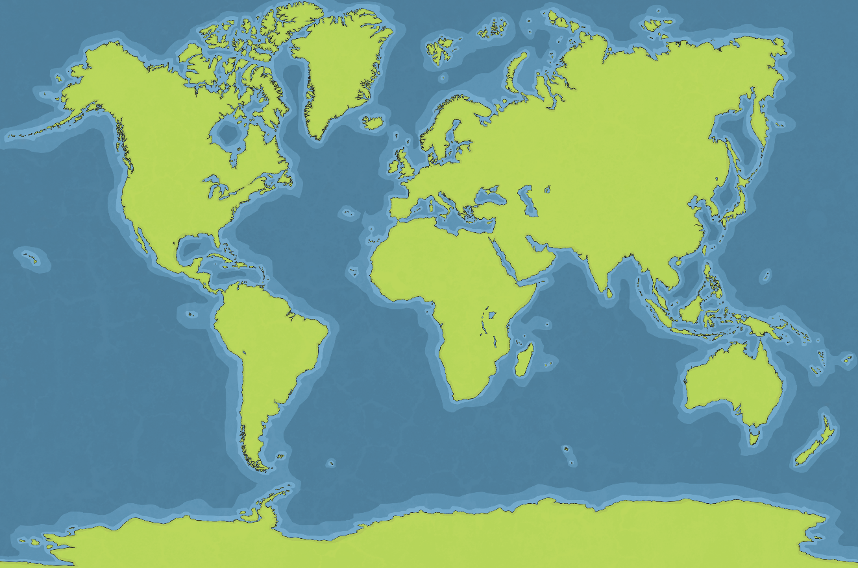
Plants From around the World
Click the labels to see which plants are from the area selected.
Arctic
North America
Europe
Asia
Africa
South America
Australasia
Antarctic
Finished

Slide 3
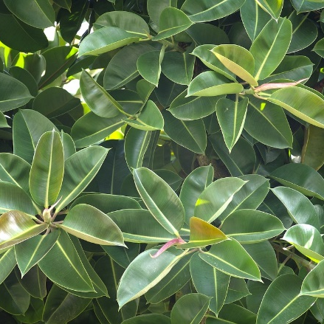
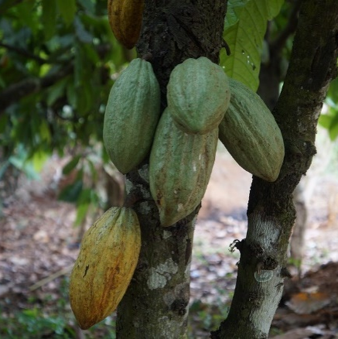
South America
]
]
rubber tree
cacao tree

Slide 4
Rubber Tree
Rubber trees like to grow in hot, damp environments, like a rainforest.
Rubber trees produce a milky white sap, which can be harvested to produce the material rubber.
It has glossy, green, oval-shaped leaves.

Slide 5
Cacao Tree
Cacao beans grow on cacao trees.
Chocolate is made using cacao beans.
Cacao trees can grow up to 15m tall.
They grow in tropical places which are warm and moist, like a rainforest.

Slide 6
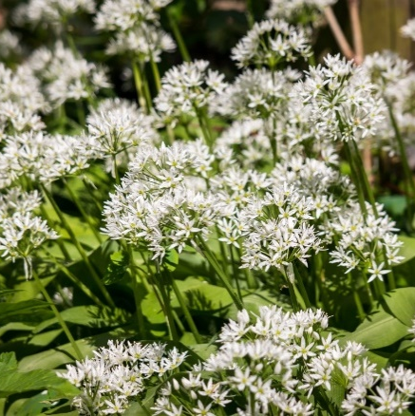
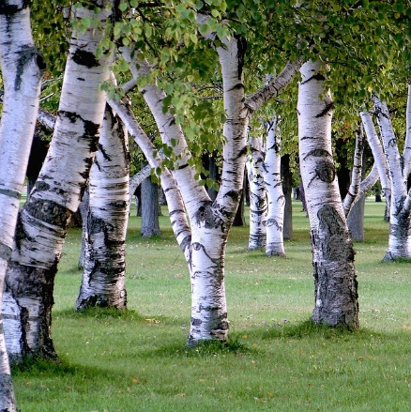
Europe
carraway plant
silver birch

Slide 7
Carraway Plant
Carraway plants are often found growing in the wild.
The fruit of the caraway are called seeds.
The plants like to grow in moist, chalky soil.
The plants grow in the UK, Poland, Hungary and Czech Republic.

Slide 8
Silver Birch
The silver birch is a tree which can grow up to 25m tall.
They have slim trunks with drooping branches.
Silver birch trees have a flaky bark, which stops other plants growing up them.
They often grow in forests.

Slide 9
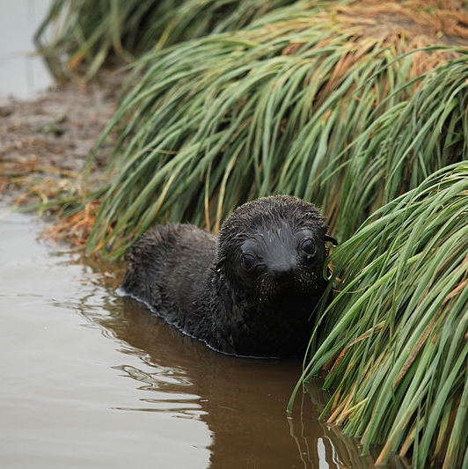
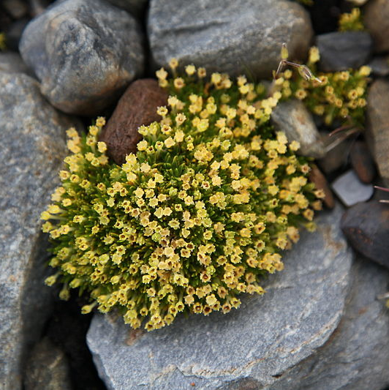
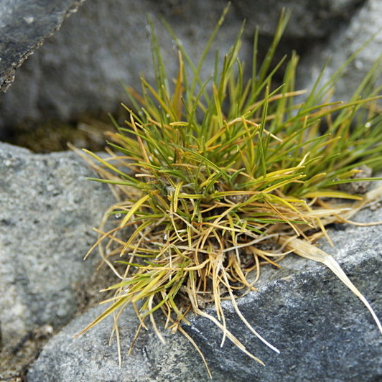
Antarctic
]
]
tussock grass
Antarctic pearlwort
Antarctic hair grass

Slide 10
Antarctic Hair Grass
Antarctic hair grass is one of only two types of flowering plants that grow in the Antarctic.
It grows 3cm to 5cm tall.
When it begins to die, the hair grass turns from green to a light-yellow colour.
It grows in-between rocks.

Slide 11
Antarctic Pearlwort
The Antarctic pearlwort is one of only two types of flowering plants that grow in the Antarctic.
It grows to about 5cm tall.
The leaves make the plant look similar to moss.

Slide 12
Tussock Grass
Tussock grass grows to 2m tall.
It grows near coasts in the Antarctic.
Tussock grass usually grow as singular plants in clumps, rather than forming a field or lawn.
It is often damaged by fur seals, who enjoy lying on it!
back

Slide 13
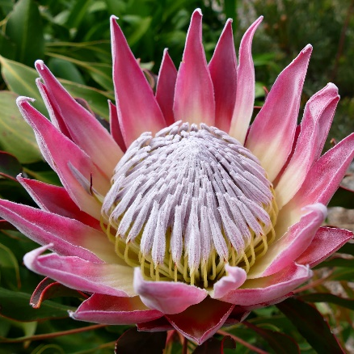
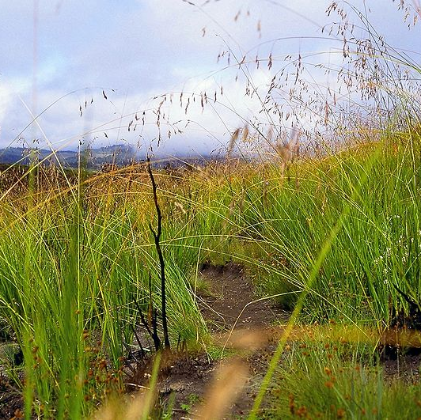
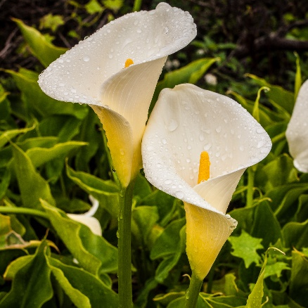
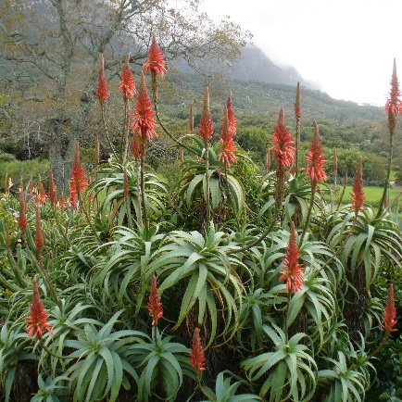
Africa
]
]
king protea
elephant grass
calla lilly
aloe
arborescens

Slide 14
King Protea
King protea is a flowering plant which comes in many different colours.
It is a woody shrub with thick stems to help it grow up to 1m high.
The leaves are glossy, which means they are protected from the extreme sun.
This plant is the national flower of South Africa.

Slide 15
Elephant Grass
Elephant grass is also called napier grass.
It is a tropical plant which is native to Africa.
It grows in areas which are dry with very little nutrients.
Lots of animals enjoy grazing on elephant grass.

Slide 16
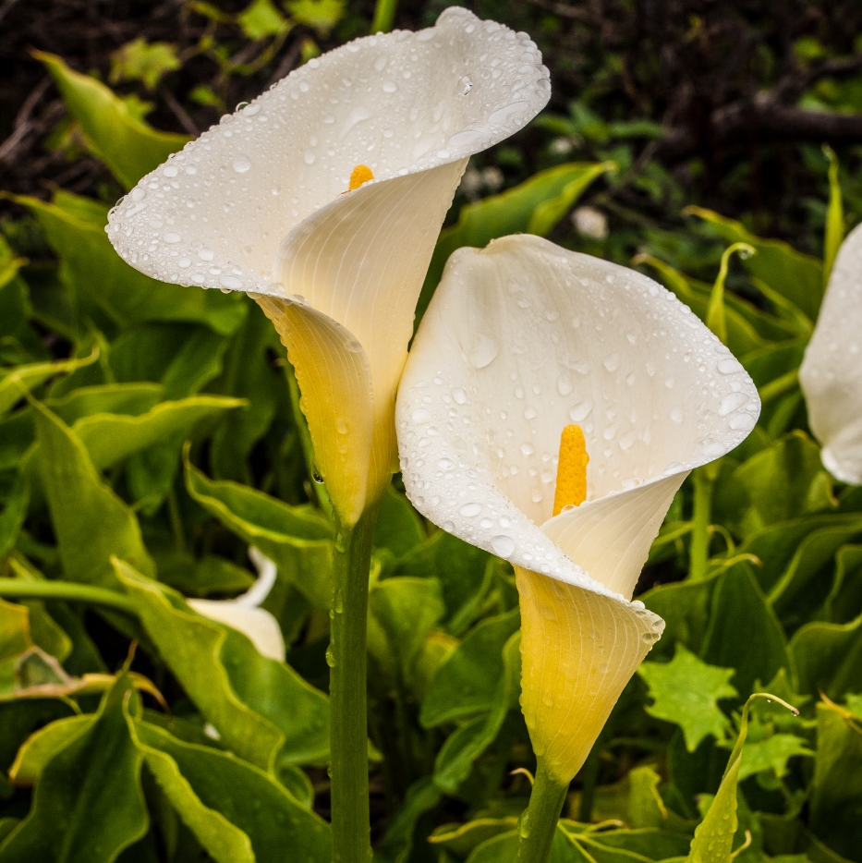
Calla Lilly
The calla lily grows in marshy places with moist soil.
They can grow up to 3ft tall.
The leaves are long, spongy and dark green.
The only season they don’t bloom in is winter.

Slide 17
Aloe Arborescens
This plant flowers in the winter.
It grows in the wild in South Africa.
The aloe arborescens can grow up to 3m tall.
It often has bright red and orange flowers.
The leaves are green with small spikes at the edges.
back

Slide 18
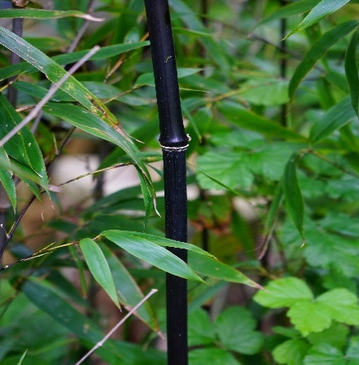
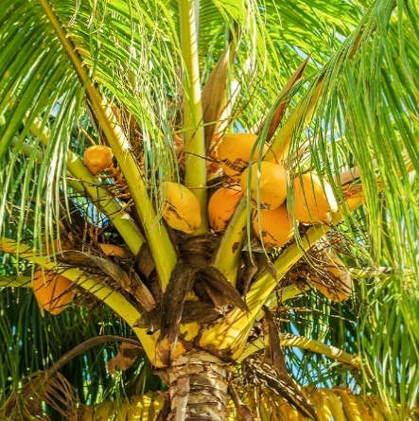
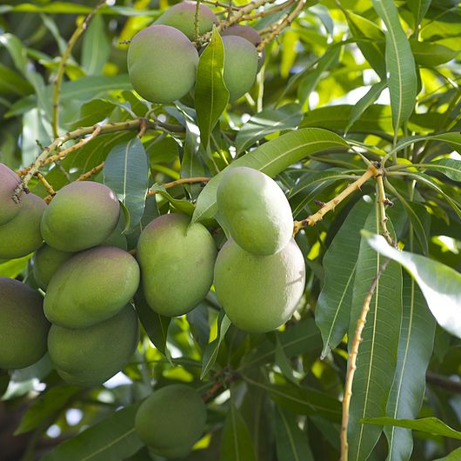
Asia
]
]
black bamboo
coconut palm trees
mango trees

Slide 19
Black Bamboo
Black bamboo is a hardy evergreen plant.
It is one of the fastest growing plants in the world.
Some bamboo plants like the sun and others like the shade.
Black bamboo can grow to be
70ft tall.

Slide 20
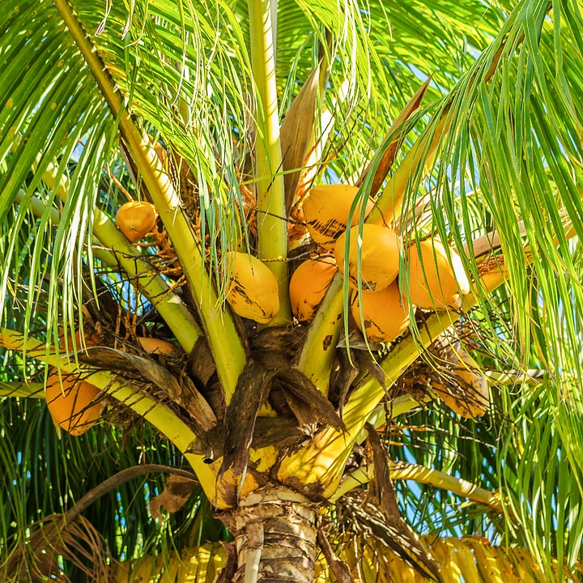
Coconut Palm Trees
Coconut palm trees like to grow in tropical environments.
The dried kernel inside a coconut is called the copra. This makes coconut oil which has many uses, such as being used in beauty products and cooking oil.
The hairy fibre on the outside of the coconut is used in mats, brooms and brushes.

Slide 21
Mango Trees
Mango trees can grow up to 40m tall.
They can live for over 300 years.
Their flowers are small and white.
Mango trees like to grow in tropical places.
back

Slide 22
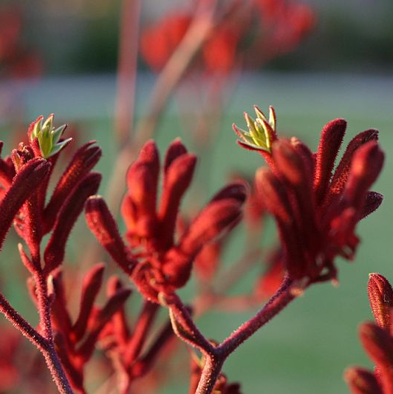
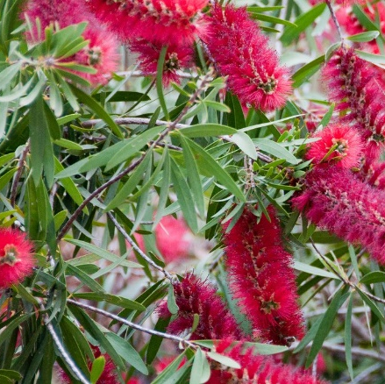
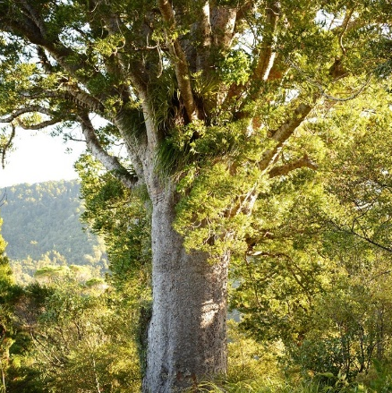
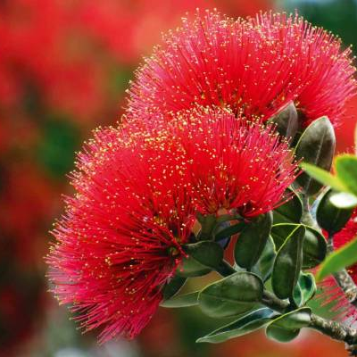
Australasia: New Zealand and Australia
]
]
kangaroo paws
bottlebrush
kauri tree
pohutukawa tree

Slide 23
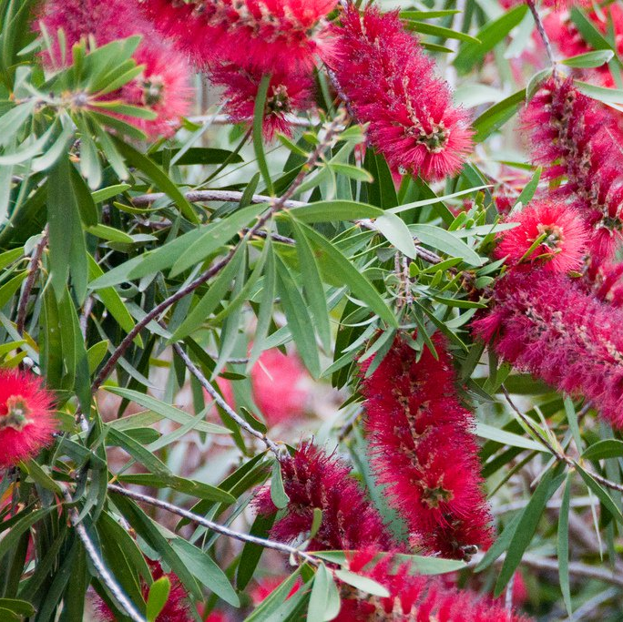
Bottlebrush Plant
The bottlebrush plant got its name because it looks like a household bottlebrush.
They grow in south-east Australia.
It likes to grow in a wet environment – particularly somewhere that floods regularly.
The pollen is on the long, coloured stalks. These are called filaments.

Slide 24
Kauri Tree
The kauri is one of the world’s oldest trees. The kauri forests are the most ancient forests in the world. The oldest kauri trees are thought to be over 4000 years old!
The kauri can grow up to 50m tall.
It has flaking bark and small leaves.
The bark protects the tree from other plants living off it.

Slide 25
Pohutukawa Tree
In New Zealand, this tree is often known as the Christmas tree because of its beautiful red flowers which bloom at Christmas time.
Pohutukawa trees can live for hundreds of years.
It grows in coastal areas and can stand strong winds and salty spray from the sea.
It has aerial roots. This means roots grow from the branches and along the trunk. They do not often reach the ground.

Slide 26
Kangaroo Paw Plant
The kangaroo paw plant grows in western Australia.
It grows in a range of different types of soil.
They have bright red flowers which are covered in fine hairs.
The kangaroo paw plant likes a lot of sunshine.
back

Slide 27
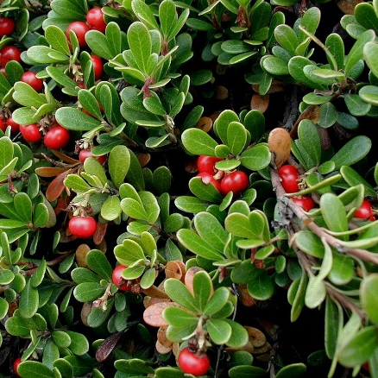
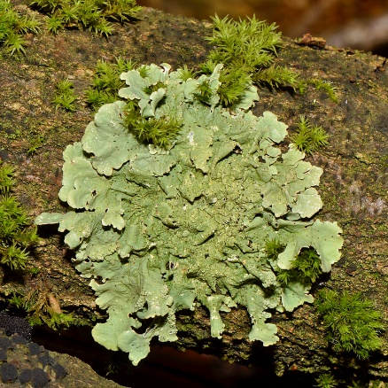
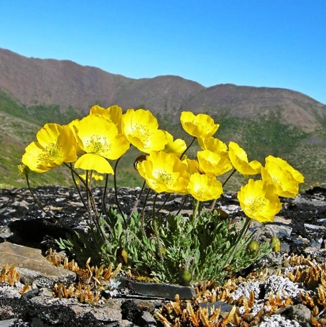
Arctic
]
]
bearberry
lichen
Arctic poppy

Slide 28
Bearberry Plant
It is called a bearberry plant because bears like to eat the berries.
It has leathery leaves and silky hairs which protect the plant from the cold and winds of the Arctic.
In the autumn, the green leaves turn red.
The flowers are white or pink.
It can grow to 15cm high.

Slide 29
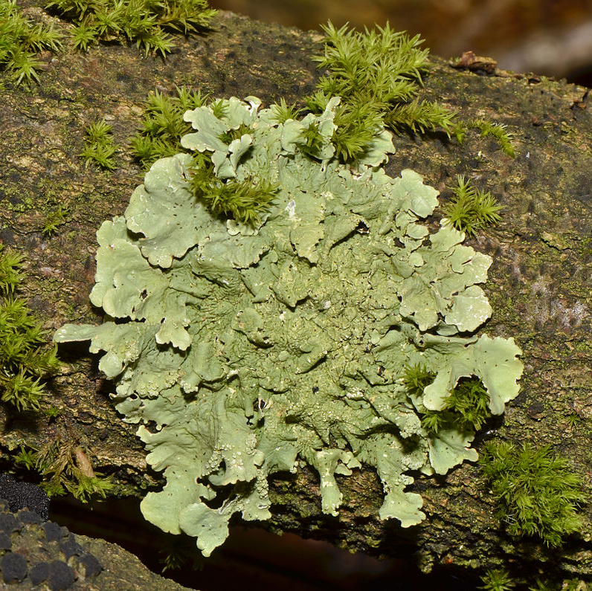
Lichen
Lichen grows in large clumps across the Arctic ground.
It grows on rocks.
Lichens are an important food for many creatures as they are full of nutrients.

Slide 30
Arctic Poppy
The Arctic poppy is a tough plant which grows on dry river beds and mountains.
The flower heads follow the sun during the day, to get as much heat and light as possible.
Their stems are covered in black hair.
They grow to be about 15cm tall with one flower on one stem at a time.
back

Slide 31
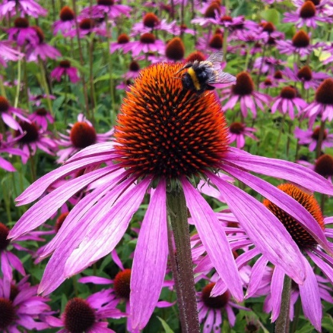
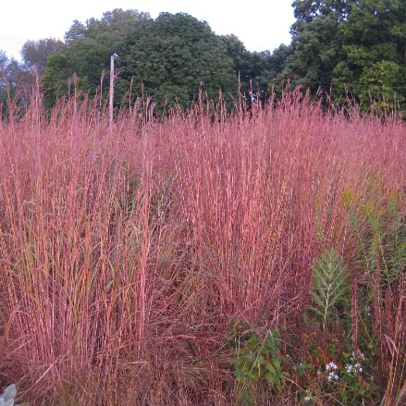
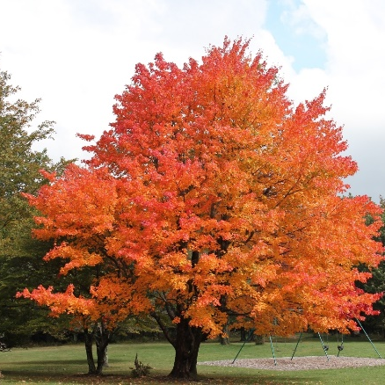
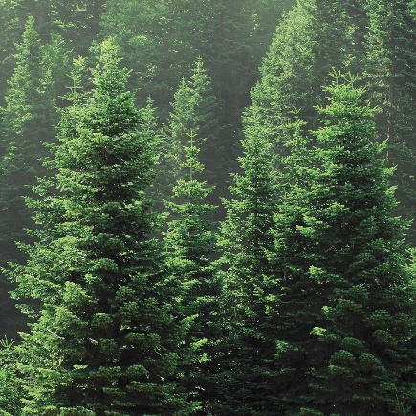
North America
]
]
echinacea
big bluestem grass
sugar maple
balsam fir

Slide 32
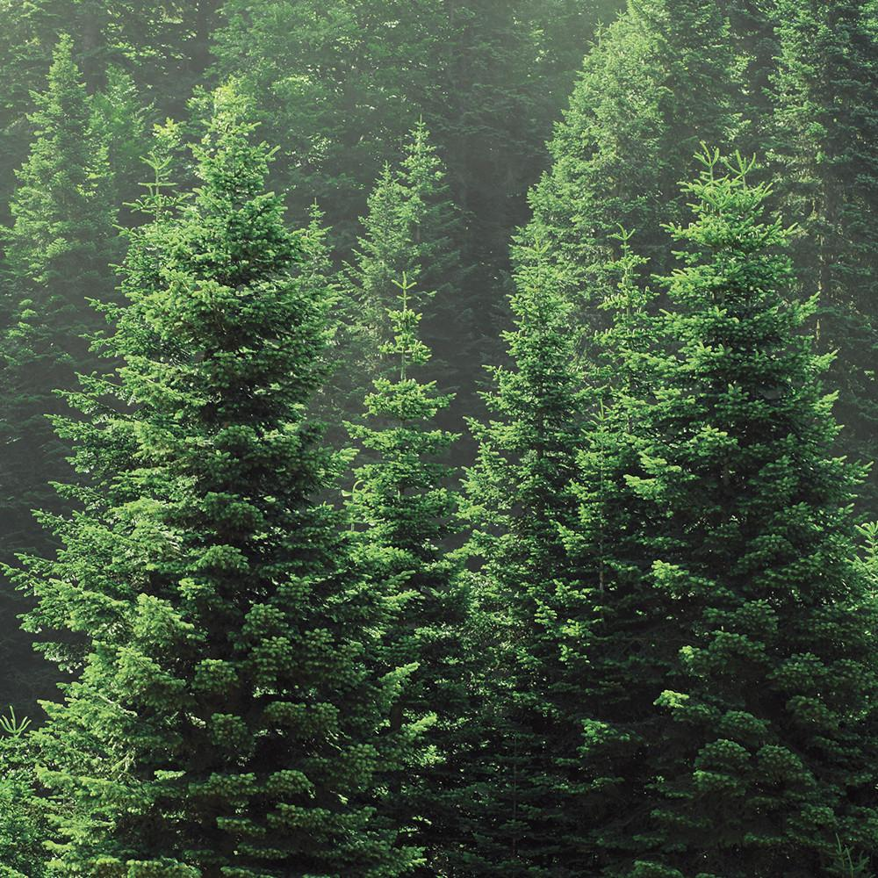
Balsam Fir
Balsam fir trees are often used as Christmas trees.
They can grow up to 20m tall.
The leaves are flat and sharp like needles.
Seed cones grow on the branches. When these fall apart, the seeds are blown away by the wind.

Slide 33
Echinacea Plant
These plants are known as coneflowers.
They have large, brightly coloured flowers to attract insects.
Different types of echinacea plants have different uses, with some being used in medicines to help people get over illnesses.

Slide 34
Big Bluestem Grass
Big bluestem grass is also known as turkeyfoot and bluejoint grass.
It can grow in different types of soil, sometimes up to 3m tall.
Farmers use it to feed cattle and horses.

Slide 35
Sugar Maple
Sugar maple trees grow to 35m tall.
They are recognised for their bright red leaves in the autumn.
They can grow in much cooler temperatures than many other trees.
Maple syrup comes from the sugar maple trees.
back

Slide 36
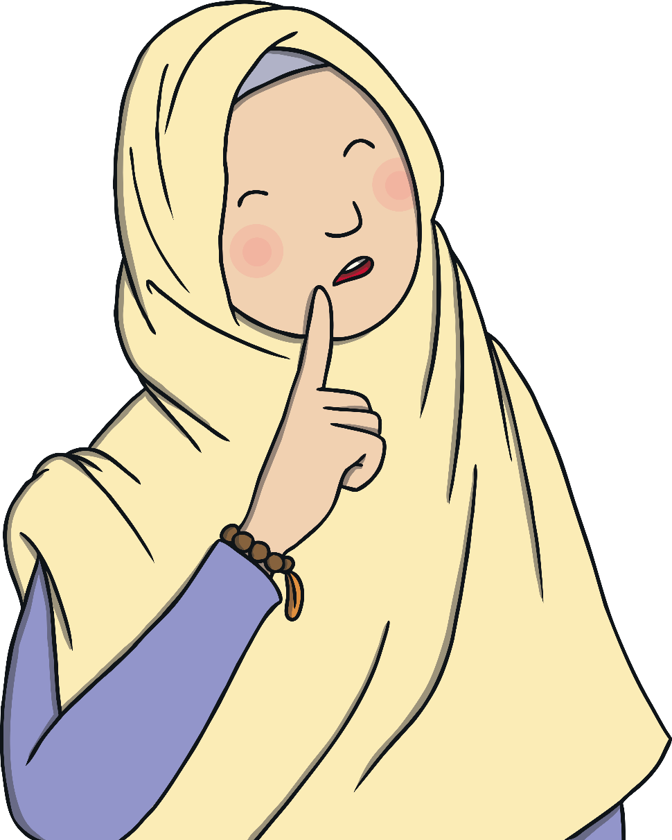
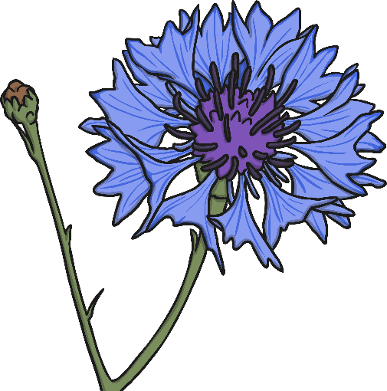
What Have You Learnt?
Which was your favourite plant?
Can you remember one of the facts you have learnt?
What other plants do you know?
back

